Slide 1

Extensions of The Dynamic Programming Framework
Morgan Jones
Notes:
Hi everyone!
Thanks for attending my talk on Extensions of the dynamic programming framework.

Slide 2

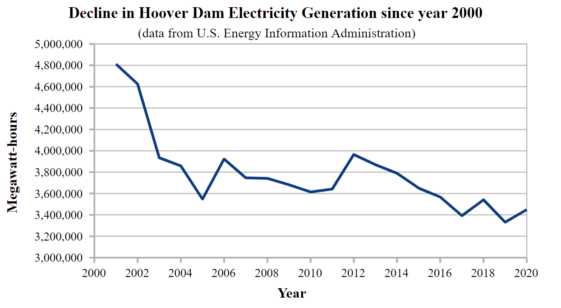
Draught is Reducing Electricity Generation of the Hoover Dam
Notes:
Its been in the news recently that Lake Mead has dropped to record low levels.
Lake mead isn’t only a reservoir but also the water used in the Hoover dam.
As a result of the lowering reservoir levels the power generated by the Hoover dam has been increasing!

Slide 3
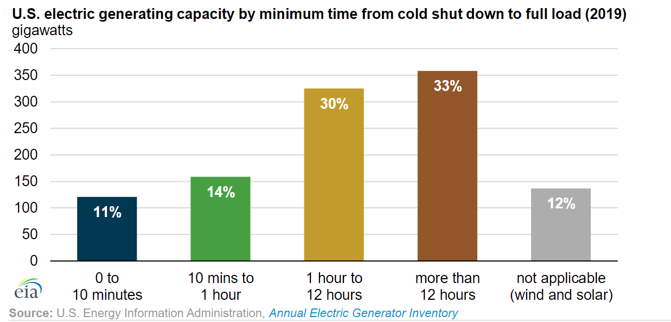
Hydro Turbines Can Rapidly Come Online to Meet Demand
Mostly steam powered turbines
Mostly nuclear power stations
Mostly hydro powered turbines
Notes:
Hydro turbines like the Hoover dam have a special property that that theyre able to come online from a cold start nearly instantly by releasing reservoir water.
The graph shows that about 11% of power in America comes from Hydro turbines.
Steam powered generators that use fossil fuels to heat up water take over an hour to come online to get the water the correct pressure.
Nuclear power stations take the longest to turn on.
If there is a power surge then the Hoover dam is able to turn on to meet demand. However this is becoming increasingly difficult.

Slide 4




Why its important to have Generators that can come online quickly?
Summer temperatures in Phoenix regularly exceed 40$°C.$
Phoenix metro area has a population of 4 million people.
Phoenix is the second fastest growing city in America.
Over 20% of Phoenix residents are over 65.
Combined with the fact that the Hoover dam electrical output is declining we may get more power cuts
Heat waves put tremendous strain on the power grid. Air conditioning units and other appliances can cause power surges.
Notes:
The Hoover dam provides a large amount of power to Phx and helps prevent power cuts.
Phx is particularly susceptible to power surges due to the heat.
Phx has an older population that require constant AC.

Slide 5
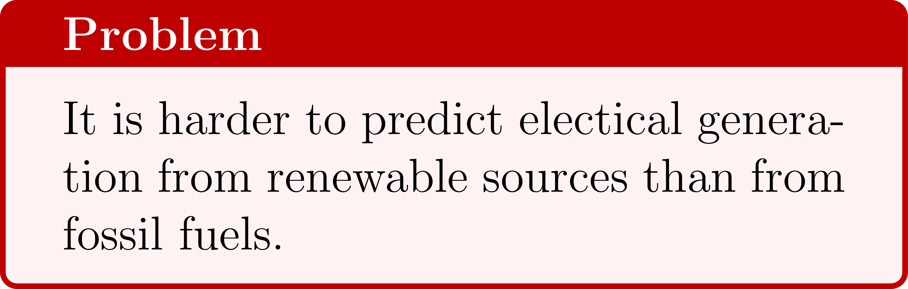


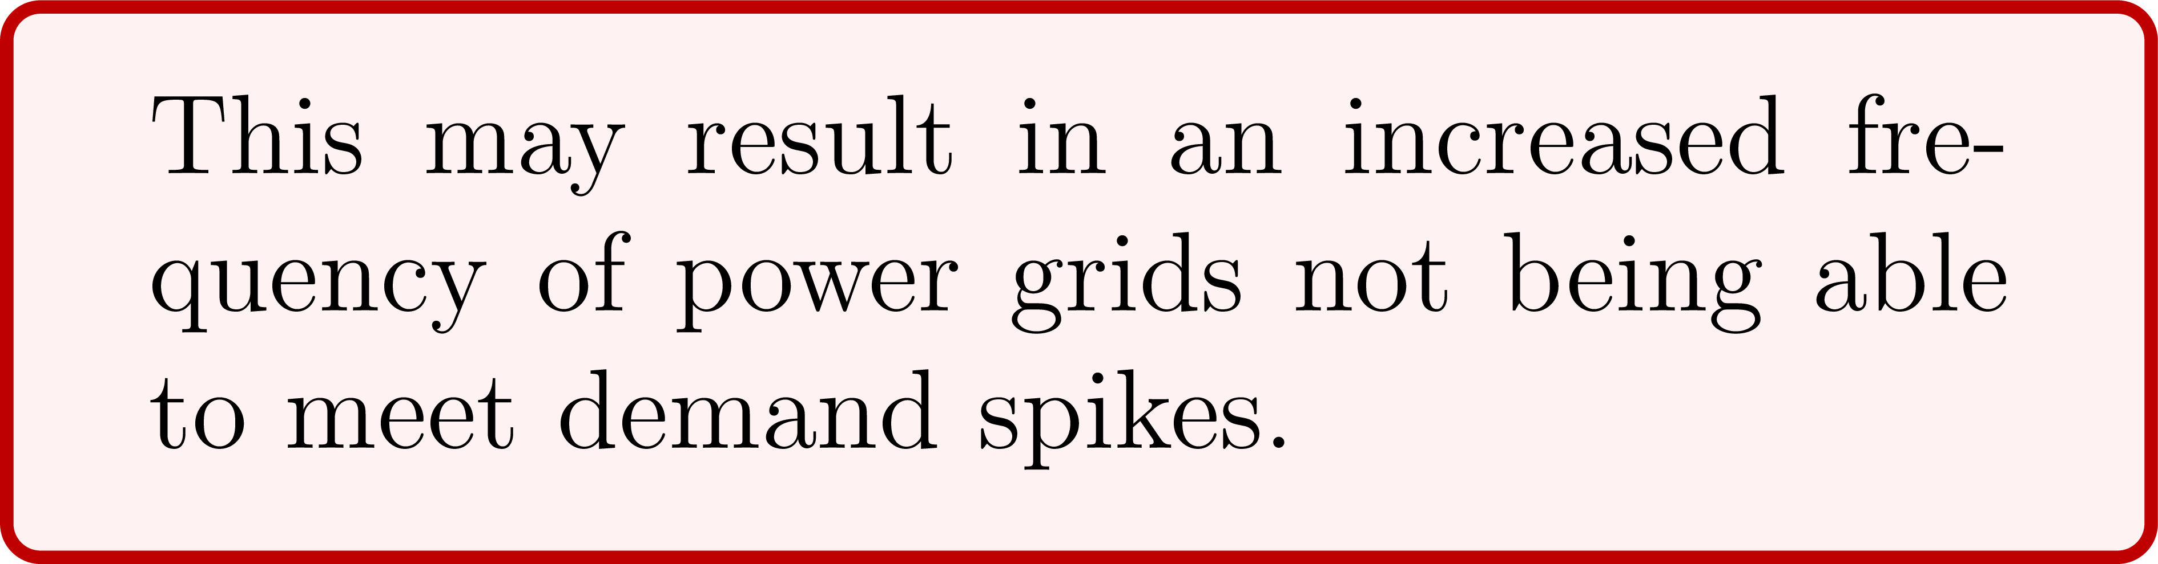
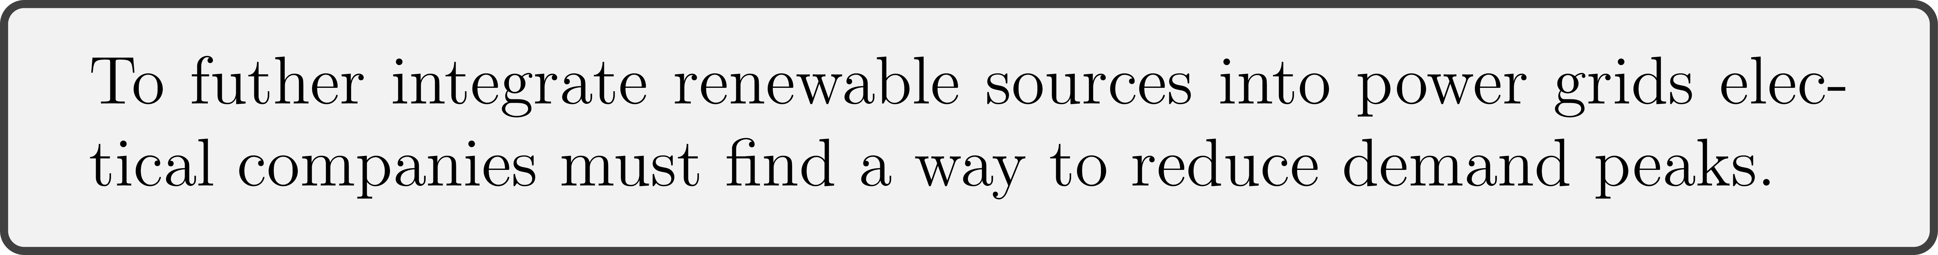
Electrical Demand Spikes are becoming more Common
Countries are integrating more forms of renewable energy into their electrical grid.
Clouds can pass over solar panels.
Weather can change and the wind may stop blowing.

Slide 6
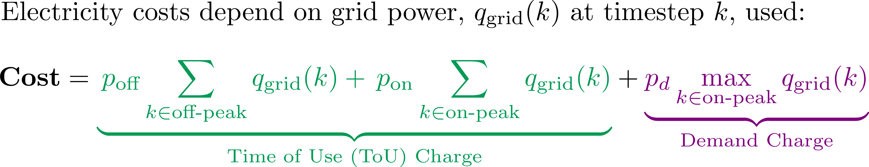
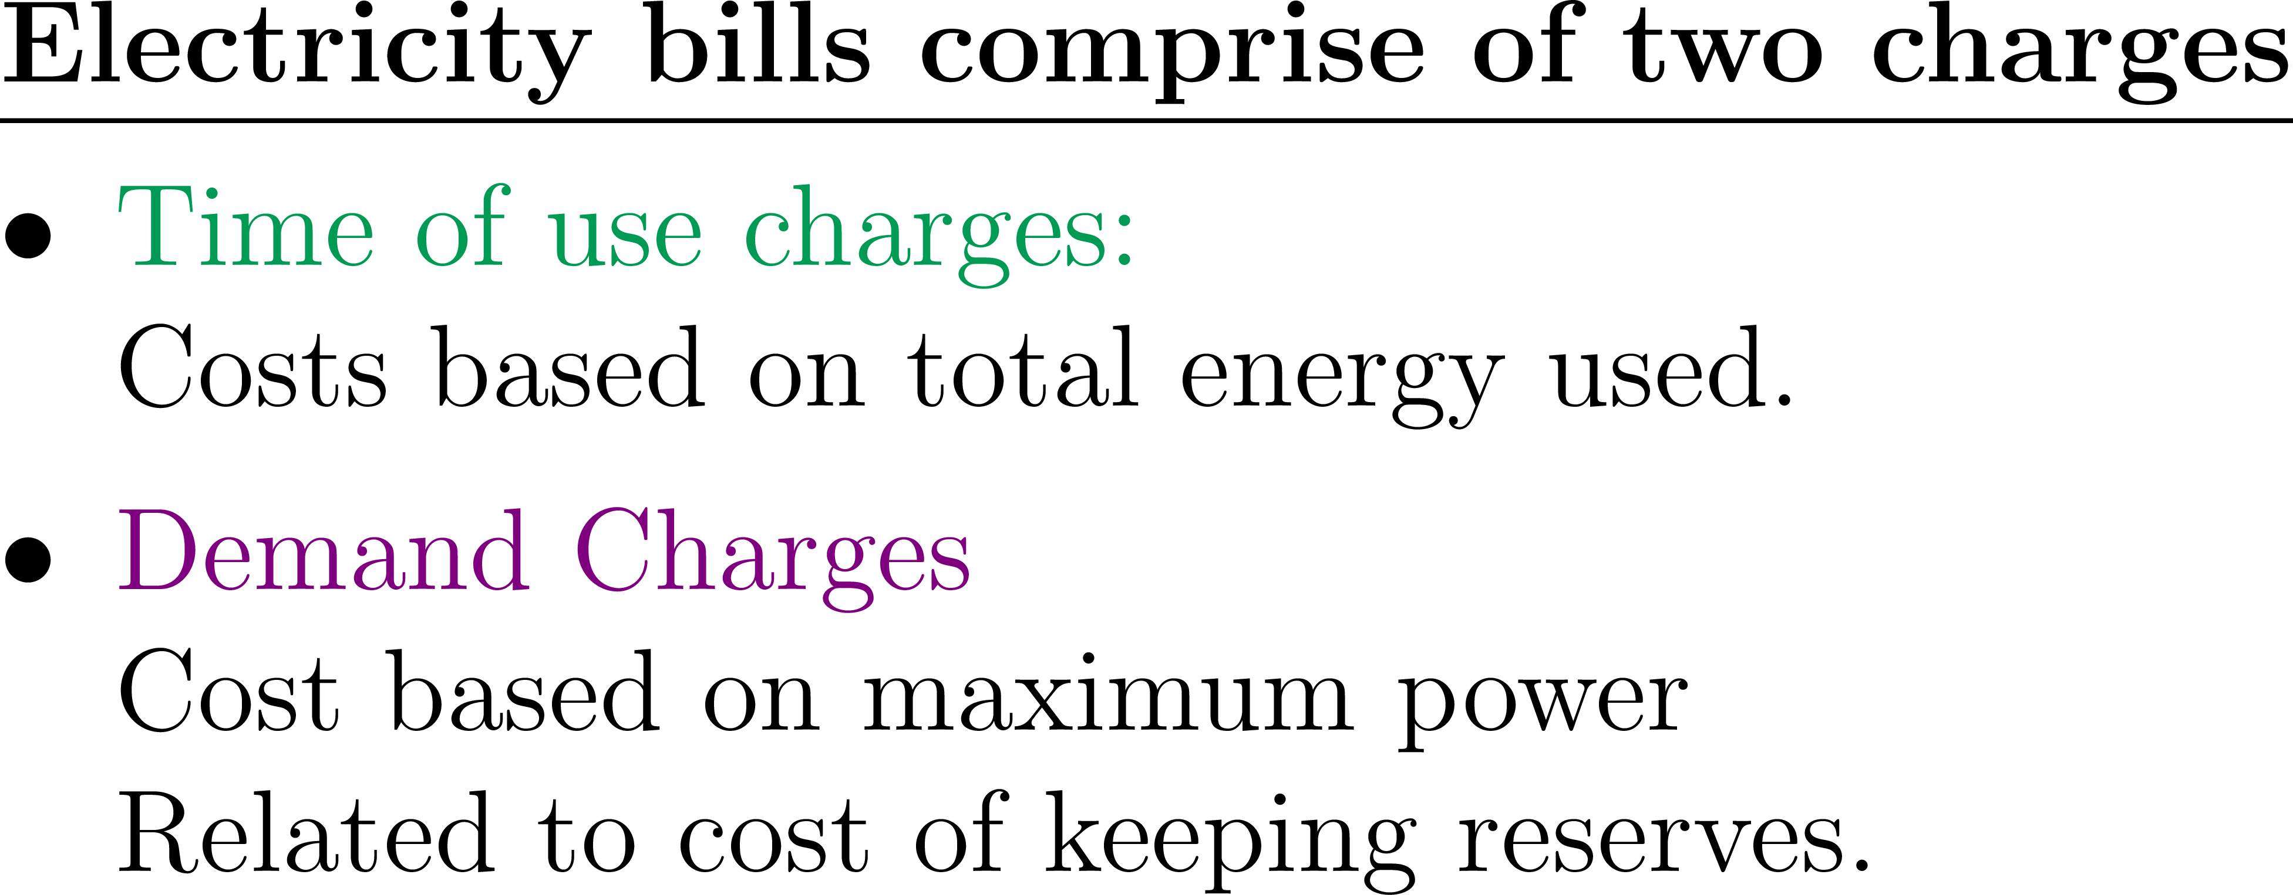
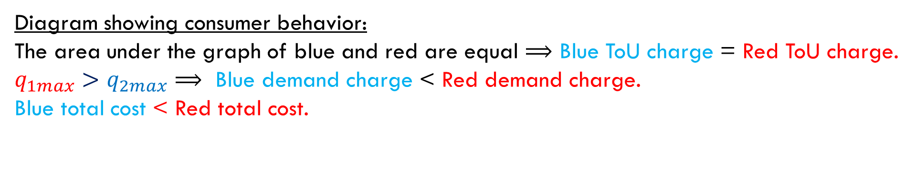
To Curtail Power Surges Electricity Companies Have Introduced Demand Charges
Diagram showing consumer behavior:
The area under the graph of blue and red are equal $⟹$ Blue ToU charge = Red ToU charge.
$q_{1max}>q_{2max}$ $⟹$ Blue demand charge < Red demand charge.
Blue total cost < Red total cost.
Notes:
Because of the growing population and the reduced power generation of the Hoover dam electricity companies have began penalizing the maximum power required by consumers by introducing demand charges.
Electricity costs can now be broken down into ToU charges based on total power required and demand charges based on max power required.
The blue and red customers use the same amount of energy but the red customer has a larger maximum power and hence incurs a larger electricity cost.

Slide 7
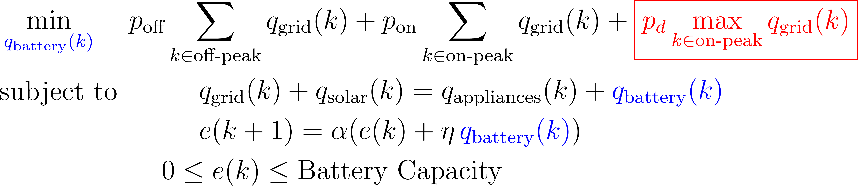
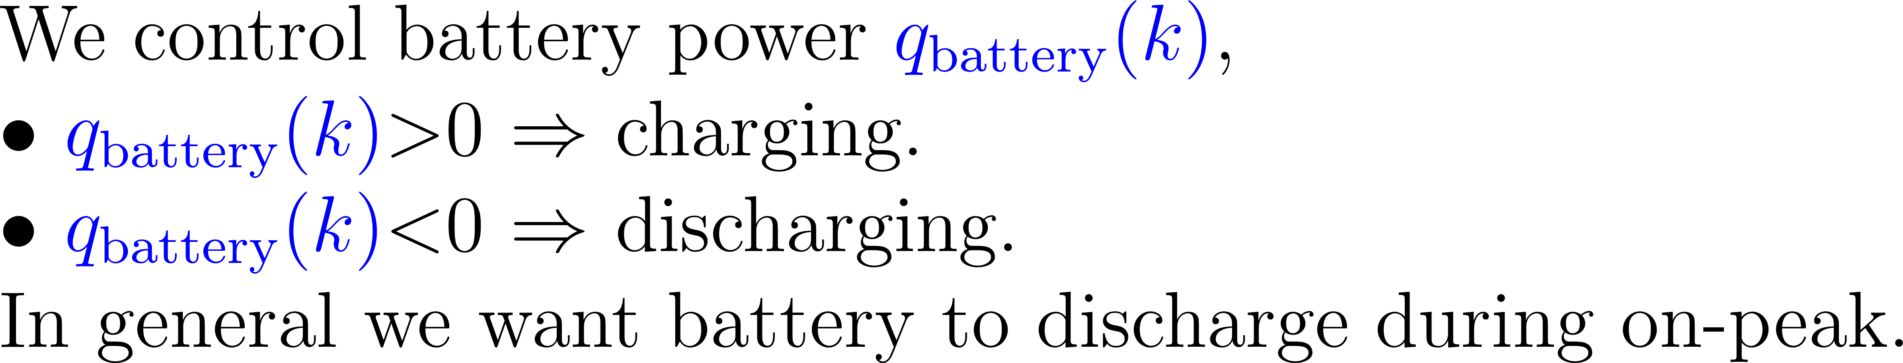
Residential Batteries Can Reduce Consumer Bills
Energy storage can be used to reduce
consumer electricity bills.
Residential batteries can be charged and
discharged to reduce peak power consumption.
An optimization problem for residential battery scheduling:
This Problem is hard!
The objective/cost is not additively separable!
Notes:
What can consumers due based on these new electricity costs?
Consumers can install a residential battery that can discharge to reduce max power consumption.
We can formulate an optimization problem solved by the controller that optimally discharges and charges to minimize consumer bills.
This optimization problem is hard to solve because the objective has a nonlinear max term.

Slide 8
Contents
In order to solve the battery scheduling problem let us first recall classical DP Theory.
Classical Dynamic Programming
Multi-Stage Optimization Problems
Bellman’s Equation
Extensions of the DP Framework: Current Research
Dynamic Programming state augmentation methods.
A Generalization of Bellman’s Equation.
Using SOS to Solve The HJB PDE.
Converse Lyapunov Theory.

Slide 9
What is Dynamic Programming?
Dynamic Programming (DP) is a class of methods used to solve optimization problems.
3
All such methods:
Indirectly solve the optimization problem by solving a sequence of simpler sub- problems.
Store information about the solution to each of the solved sub-problems.
Use the stored information to help solve the next unsolved sub-problem in the sequence.
-2
-3
2
5
6
1
1
2
2
Finding the shortest path between nodes is often solved using DP.
Notes:
Dynamic Programming is a class of methods that all posses the following characteristics.
These algorithms computationally out preform brute force methods because they use stored information to avoid repeating calculations.
An example of a problem of that is solved using DP is finding the shortest path between nodes. You can see from this example if we were to only act localy then we would go up rather than down.

Slide 10




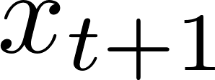

The Type of Problems we Solve Using DP
Action/input:
Multi-Stage Optimization Problems (MSOPs) are solved by finding the sequence of inputs/actions that maximizes the reward/ minimizes cost.
MSOPs have several flavors:
Model based vs model free.
Finite time vs infinite time.
Deterministic vs stochastic.
State :
Agent
Environment
State update:
The cost depends on the previous state of the agent and input selected
Reward/cost:
Note, in the second half of this talk we will consider the analogous continuous time formulation of this problem
Notes:
In MSOPs have an agent that is able to execute an action.
An environment/simulator then gives feedback of which state the agent moves to and a reward the agent gets.
The goal is to find the sequence of actions that maximize the total rewards gained.

Slide 11
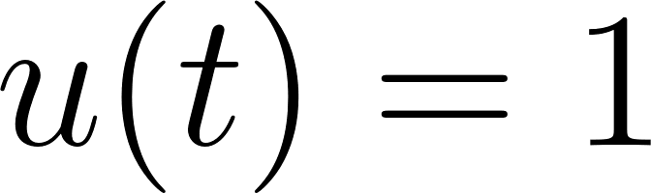

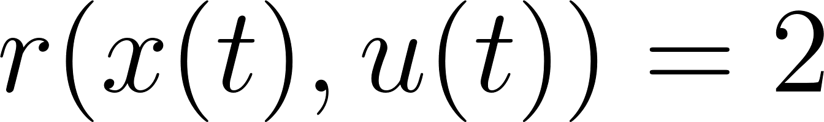
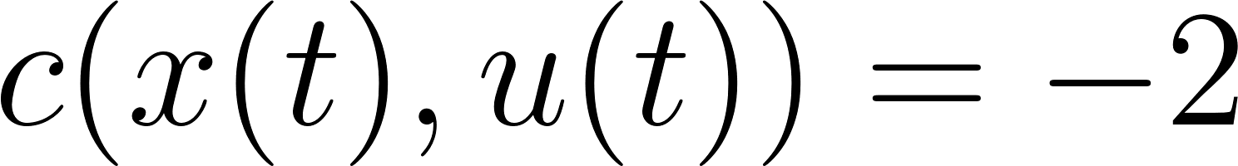
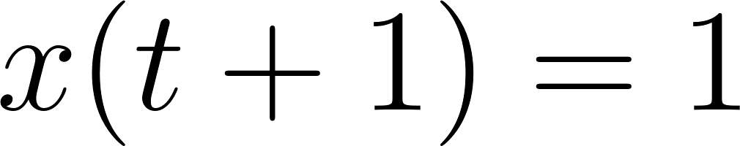

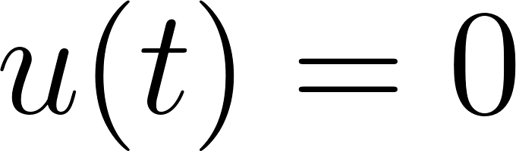
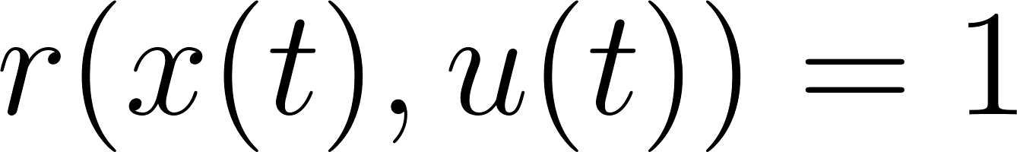
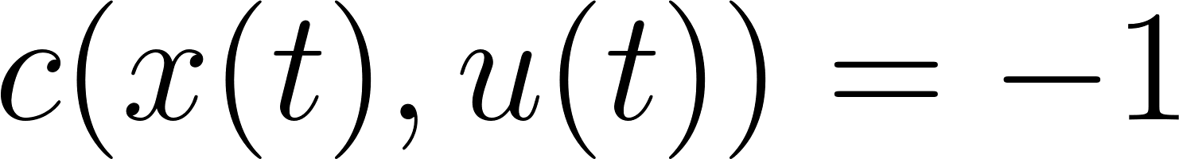
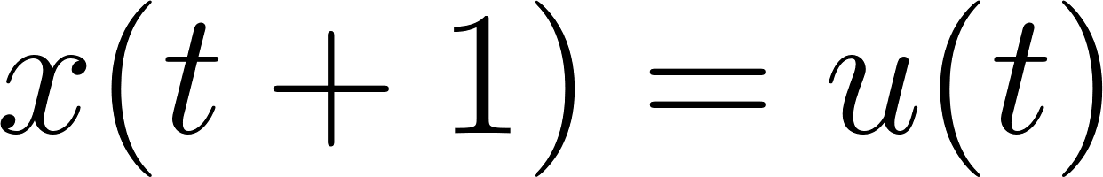
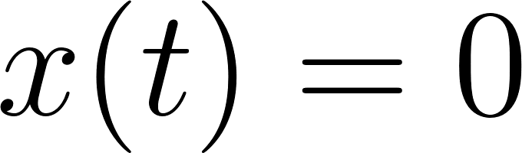
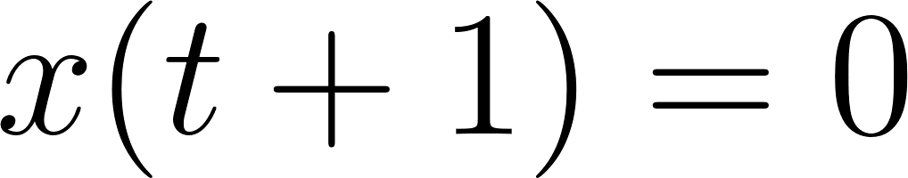

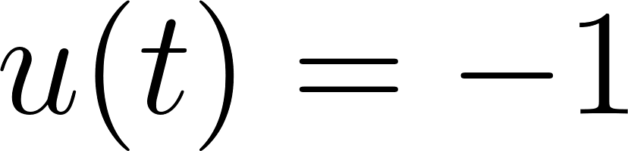
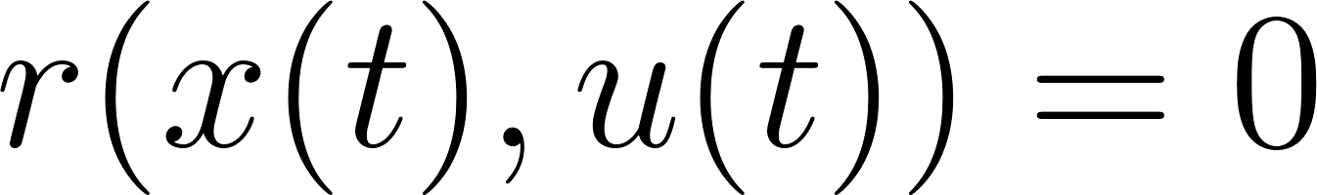
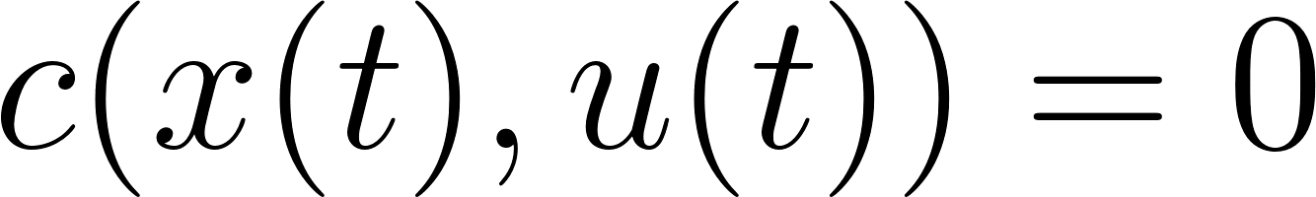
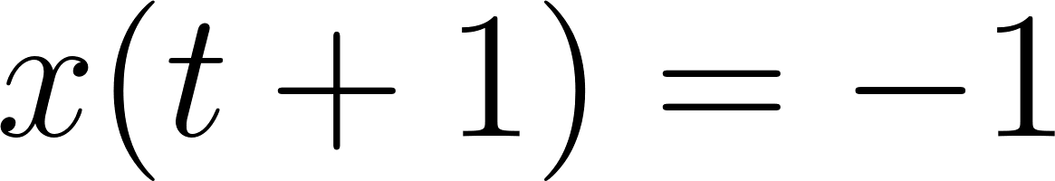
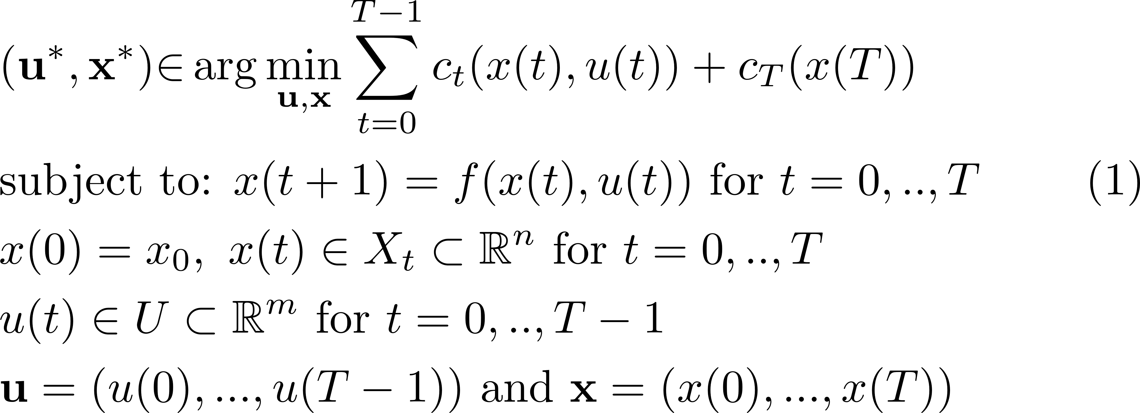
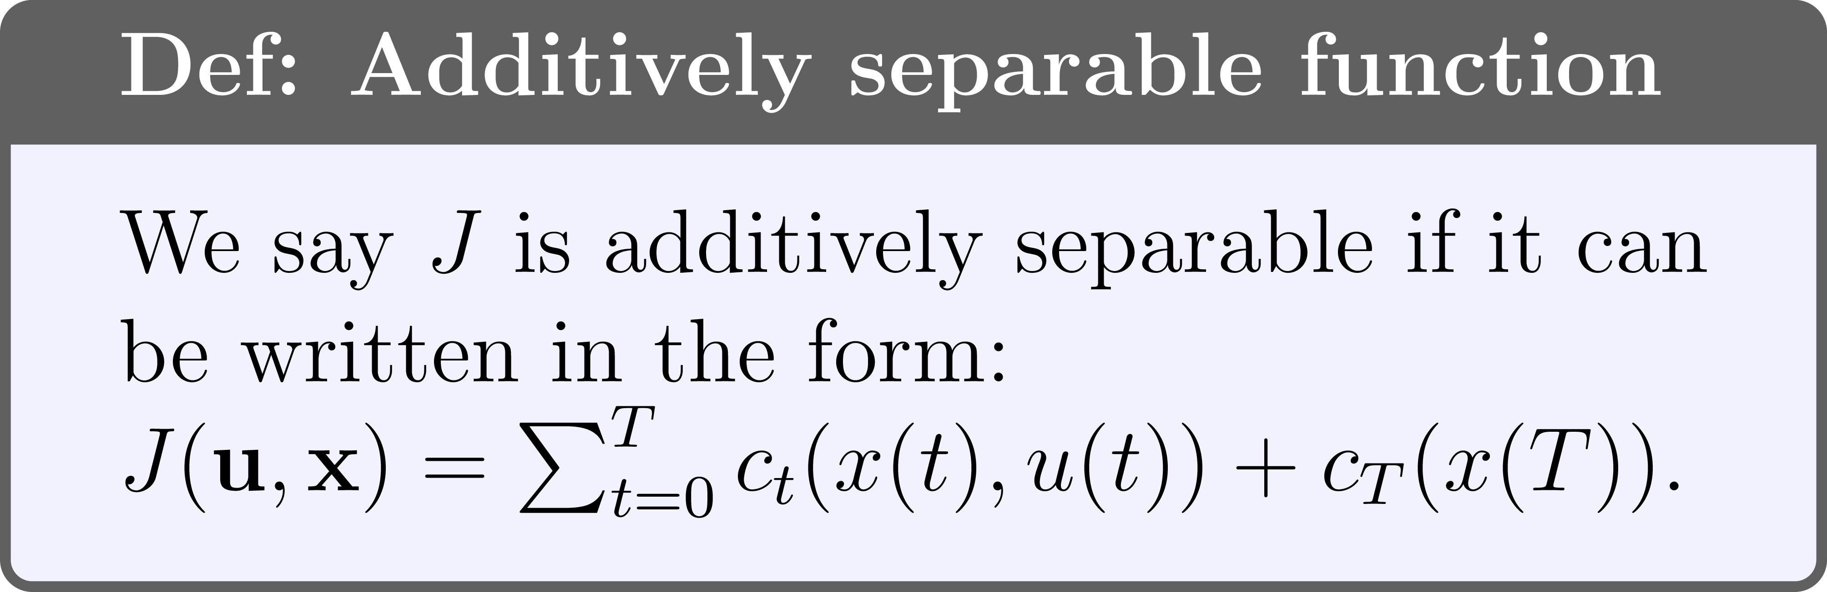
Mathematically Describing MSOPs
Equivalent formulation in terms of costs:
A one-stage example:
Dog dynamics:
State
Input
We can mathematically describe MSOPs in the following way.
Notes:
Consider a simple model of a dog.
Call the dogs rest state 0.
Depending on what action the dog takes he will transition to a new state and receive a reward.
If the dynamics and reward functions are known then we can write MSOPs as optimization problems.

Slide 12
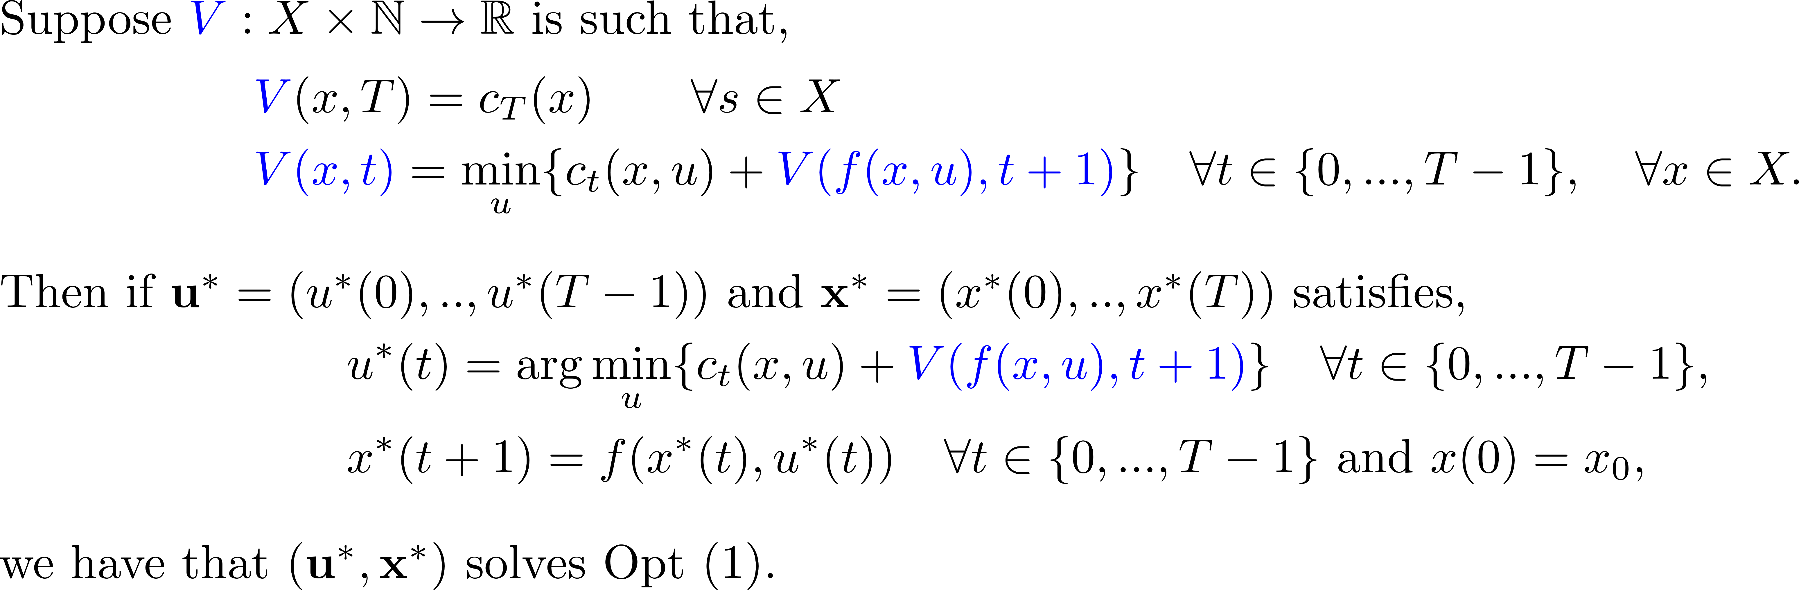
A DP Algorithm That Recursively Solves Tail Problems
Intuitively we break down the MSOP into its tail problems. This leads to a recursion equation called Bellman’s Equation.
Theorem: Bellman’s Equation
The value function stores the solution of each tail problem.
Notes:
Rather than solving (1) and obtaining all actions we can solve BE for one action at a time.
Intuitively BE solves the tail problems of the opt and saves the soln in the VF that captures the long term value of being in a certain state at a certain time.
After solving BE and getting a VF we can synthesize an action sequence.

Slide 13
Contents
Classical Dynamic Programming
Multi-Stage Optimization Problems
Bellman’s Equation
Extensions of the DP Framework: Current Research
Dynamic Programming state augmentation methods.
A Generalization of Bellman’s Equation.
Using SOS to Solve The HJB PDE.
Converse Lyapunov Theory.
We next consider my current research

Slide 14
a) Dynamic Programming State Augmentation Methods
[1] Morgan Jones and Matthew M Peet. Extensions of the dynamic programming framework: Battery scheduling, demand charges, and renewable integration. IEEE Transactions on Automatic Control, 66(4):1602–1617, 2021.
[2] Morgan Jones and Matthew M Peet. Solving dynamic programming with supremum terms in the objective and application to optimal battery scheduling for electricity consumers subject to demand charges. In 2017 IEEE 56th Annual Conference on Decision and Control (CDC), pages 1323–1329. IEEE, 2017.
Notes:
We will now discuss some of my research I did with Matthew Peet on extending the DP framework.

Slide 15
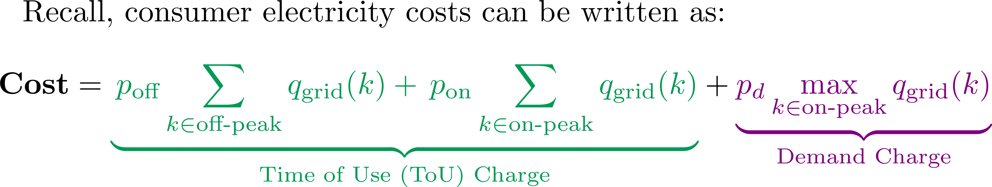
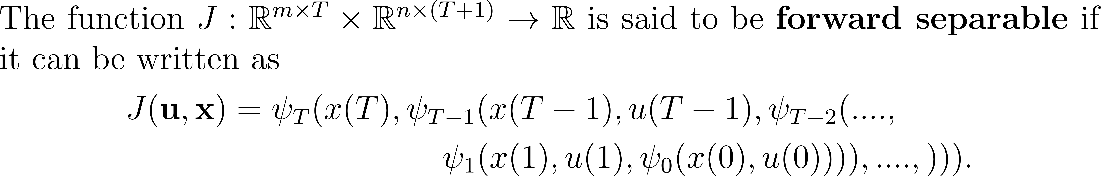
A New Class of Cost Function: Forward Separable Functions
We next introduce a new class of functions that includes the class of additively separable functions and includes functions representing ToU and Demand charge costs
Definition: forward separable function
Notes:
Electricity costs are not addative. They do not fit into the traditional RL framework where you get a reward after each action.
The max term depends on what you did in the past, not just what action you during each time-stage.
We consider a new class of cost functions called forward separable functions.
In [1] we showed all functions are FS.
FS functions share a similar structure to NN.

Slide 16
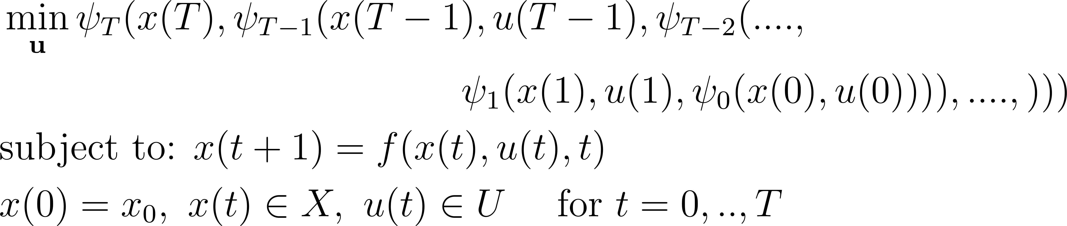
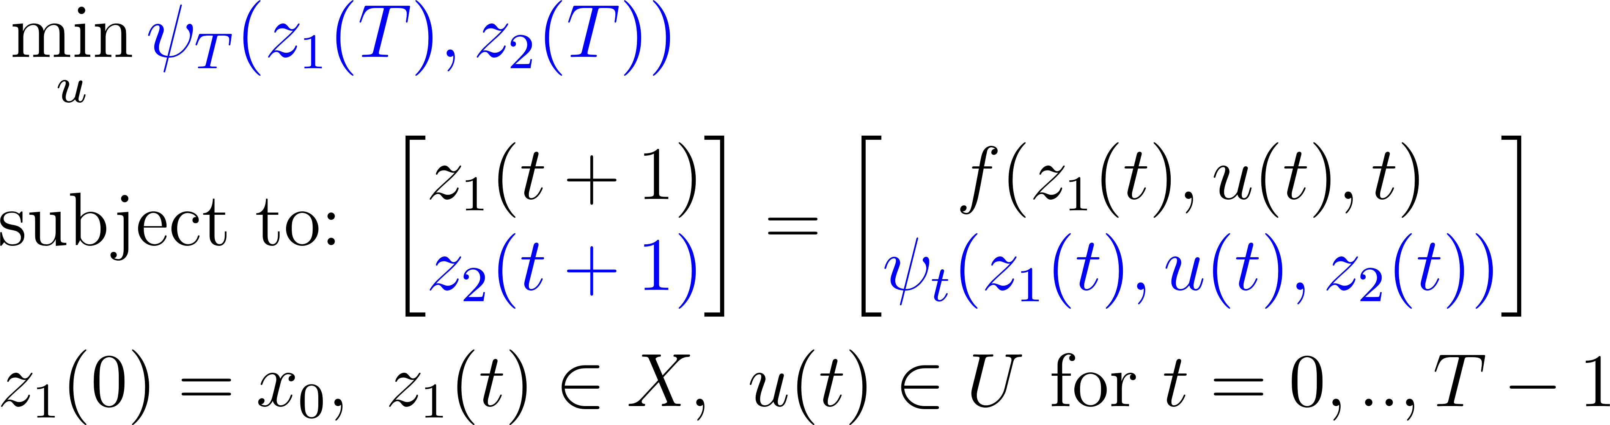

State Augmentation Can Solve Forward Separable Problems
Forward separable cost function.
Augmentation
The augmented optimization problem,
Is equivalent to the original problem.
Can be solved using Bellman’s Equation.
Has a higher dimensional state space (more complex).
Can solve any MSOP with any obj function.
Notes:
We showed we can solve Opt with FS obj functions using state augmentation.
Aspects of the cost are stored in the system dynamics.
We proved that both problems are equivalent.
The augmented problem can be solved using the BE (classical DP theory) since its obj only depends on the terminal state (additively sep).
The augmented problem has a higher dim. Therefore we must select the representation maps carefully.
Intuitively the representation maps store the information required for an agent to act optimally and propagate this through the dynamics.

Slide 17
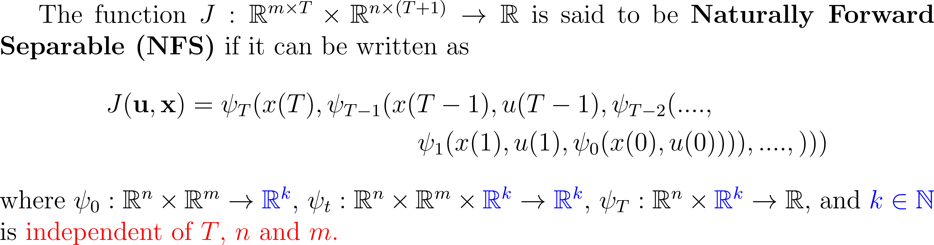
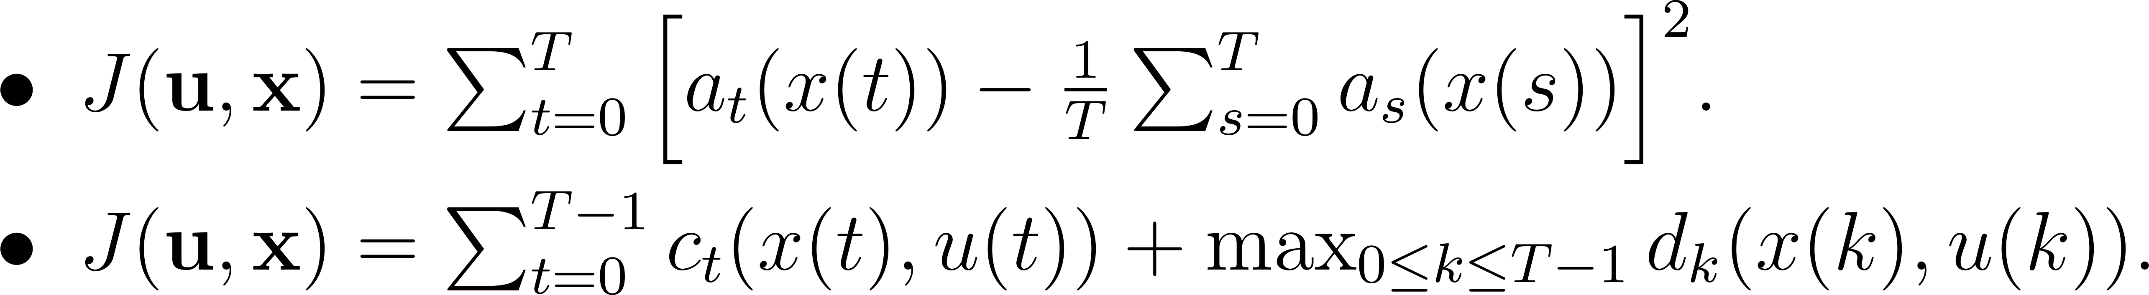
Naturally Forward Separable Functions
In [1] we proposed a new class of cost functions that yield optimization problems that are tractable to solve via state augmentation.
Definition: Naturally Forward Separable Functions (NFSFs)
Examples:
Notes:
State augmentation is only tractable when the state dimension of the augmented problem only increase by a fixed amount independent of the problems data.
For this reason we have introduced a new class of obj function whose representation functions map to a dimension that is independent of the problems data.
We have demonstrated that there’re many examples of obj functions that are NFSF including a variance type obj function and a pointwise max obj function (electricity costs).

Slide 18
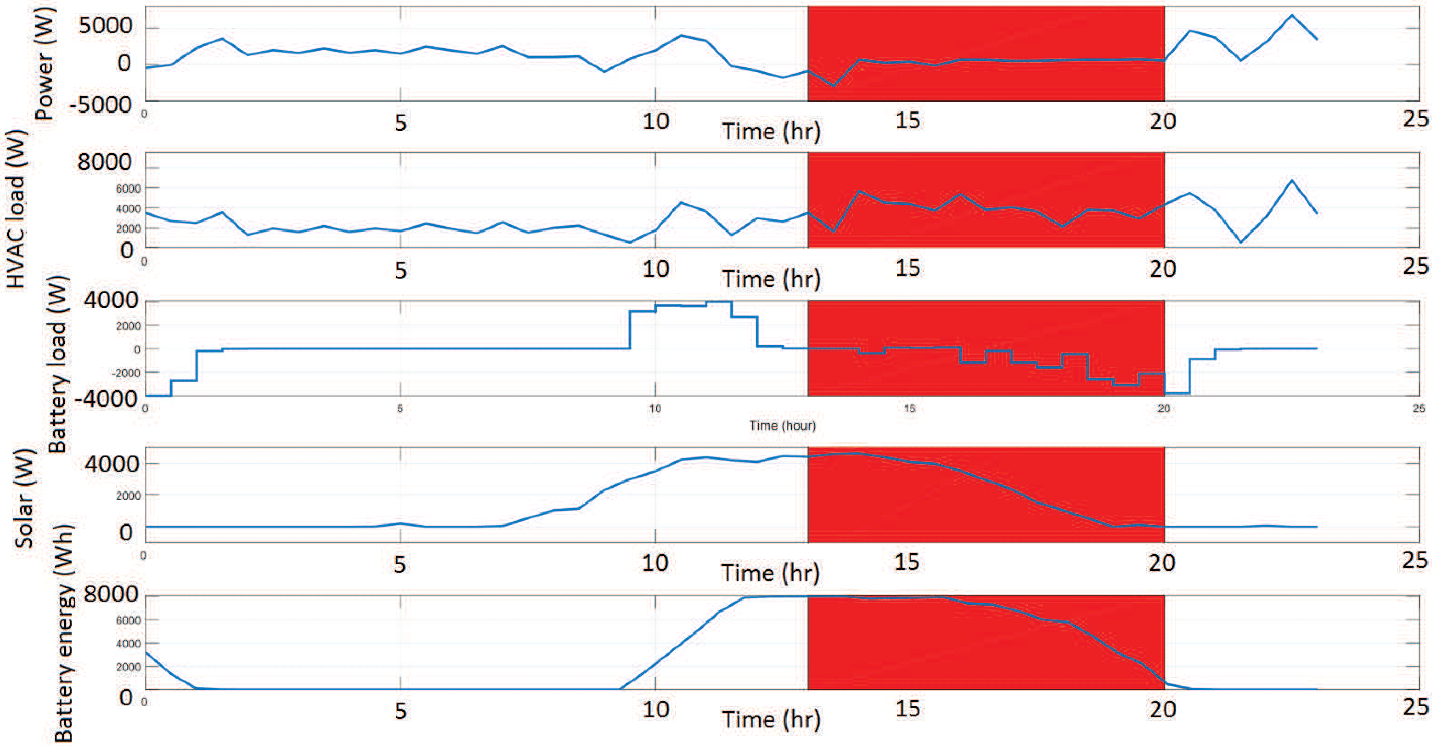
Using State Augmentation to Solve The Battery Scheduling Problem
Red represents on peak time
Derived controller/policy successfully charges battery during off peak and discharges during on peak.
Has potential to save customers money, reduce need for grid reserves, and help keep lake Mead reserves high.
Notes:
We solved the battery scheduling problem using our proposed augmented DP method.
The red region shows on-peak hours where demand charges are enforced.
The first graph shows that consumer power is stabilized and does not peak using the power the battery discharges.

Slide 19
b) A Generalization of Bellman’s Equation
[3] Morgan Jones and Matthew M Peet. A generalization of Bellman’s equation with application to path planning, obstacle avoidance and invariant set estimation. Automatica, 127:109510, 2021.

Slide 20
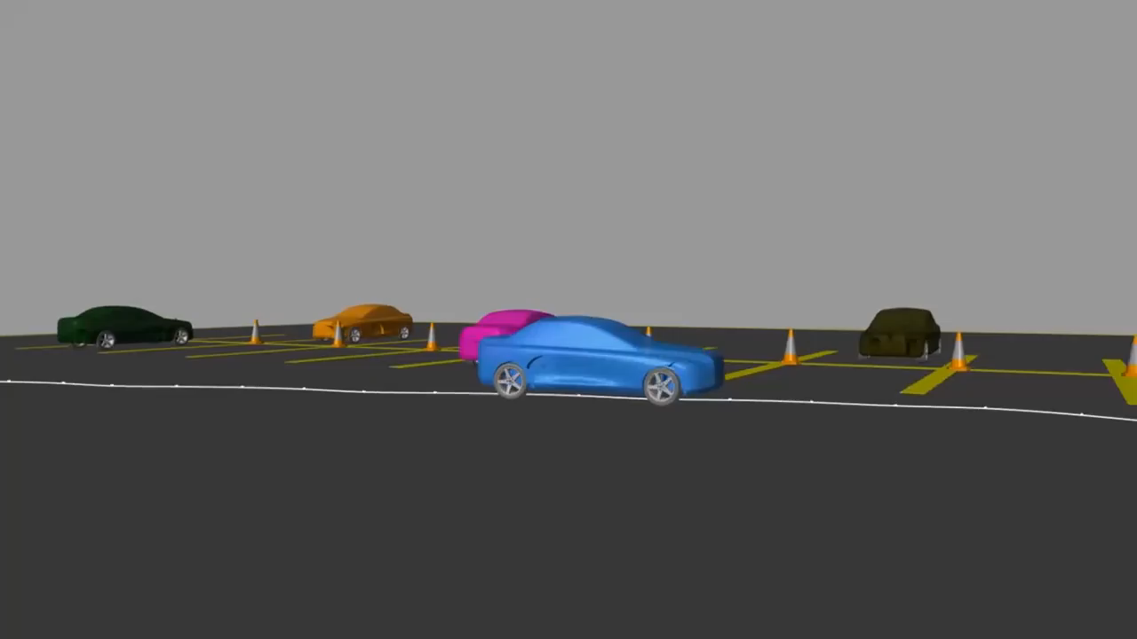
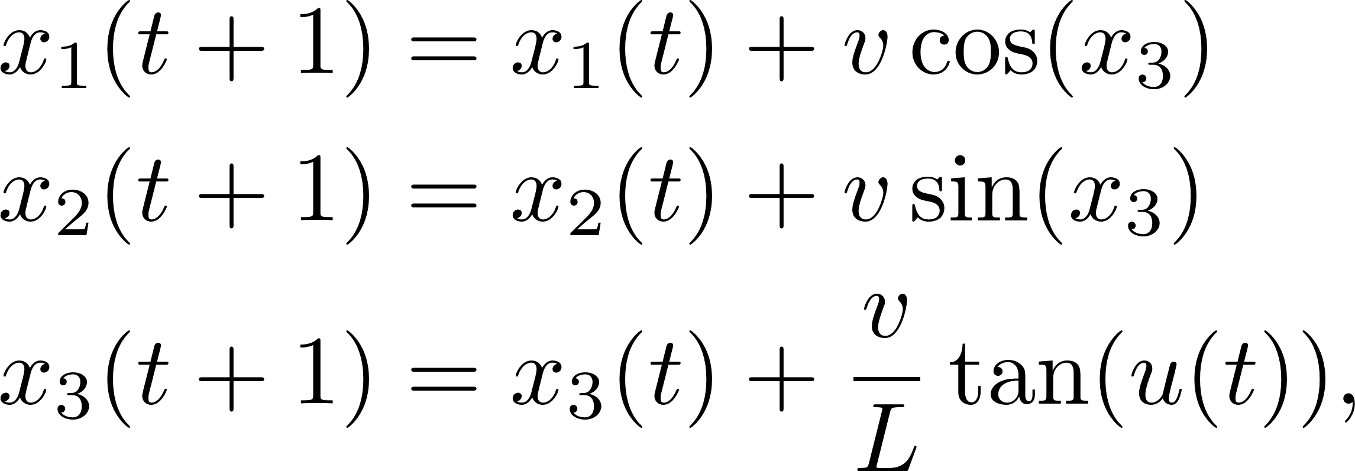


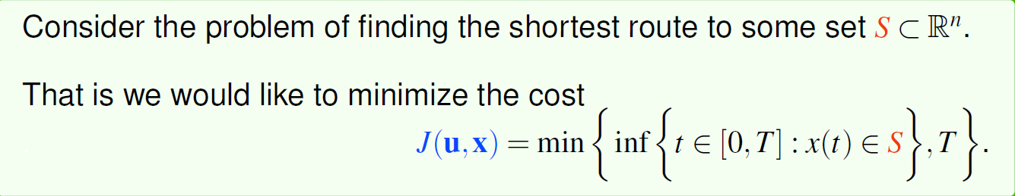
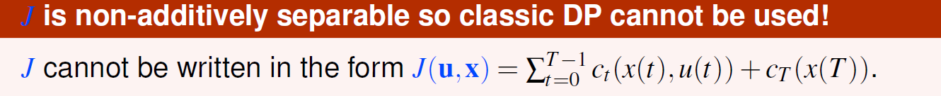
Recall: Not all Costs/Rewards are Additive
Consider Dubin’s car dynamics:
where
car velocity
turning radius
Courtesy of Mathworks
We could solve this using our state augmentation method however this increases the state space of the problem.
Notes:
Let us consider a model of Dubins car. Suppose

Slide 21
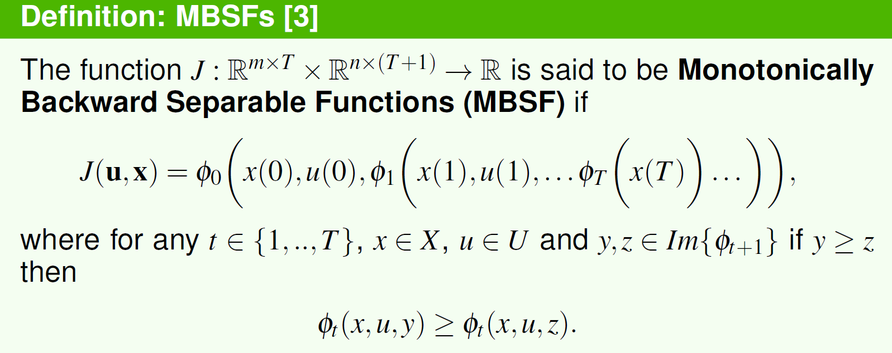
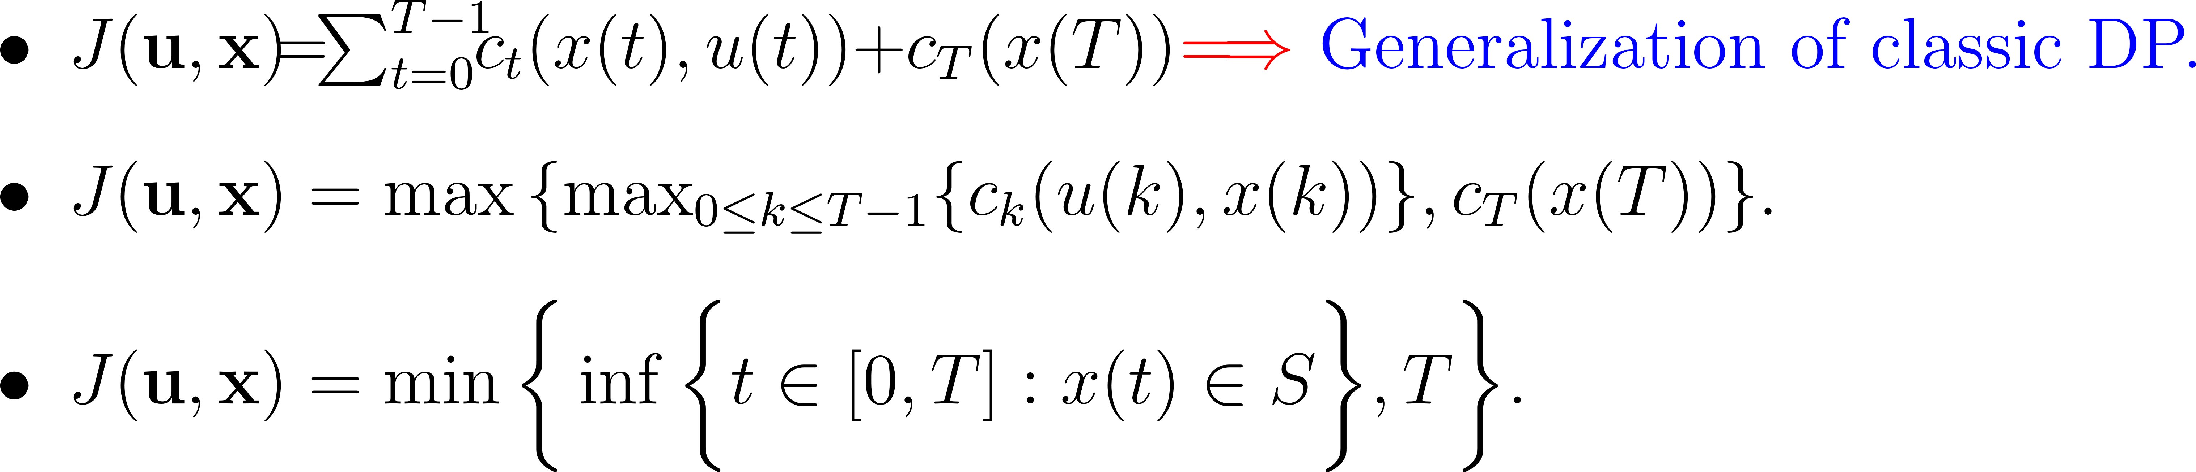
A New Class of Non-Additively Separable Cost Functions
Can we solve problems with backward separable costs without state augmentation?
Examples of MBSFs:

Slide 22
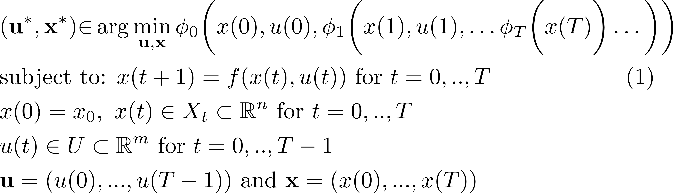
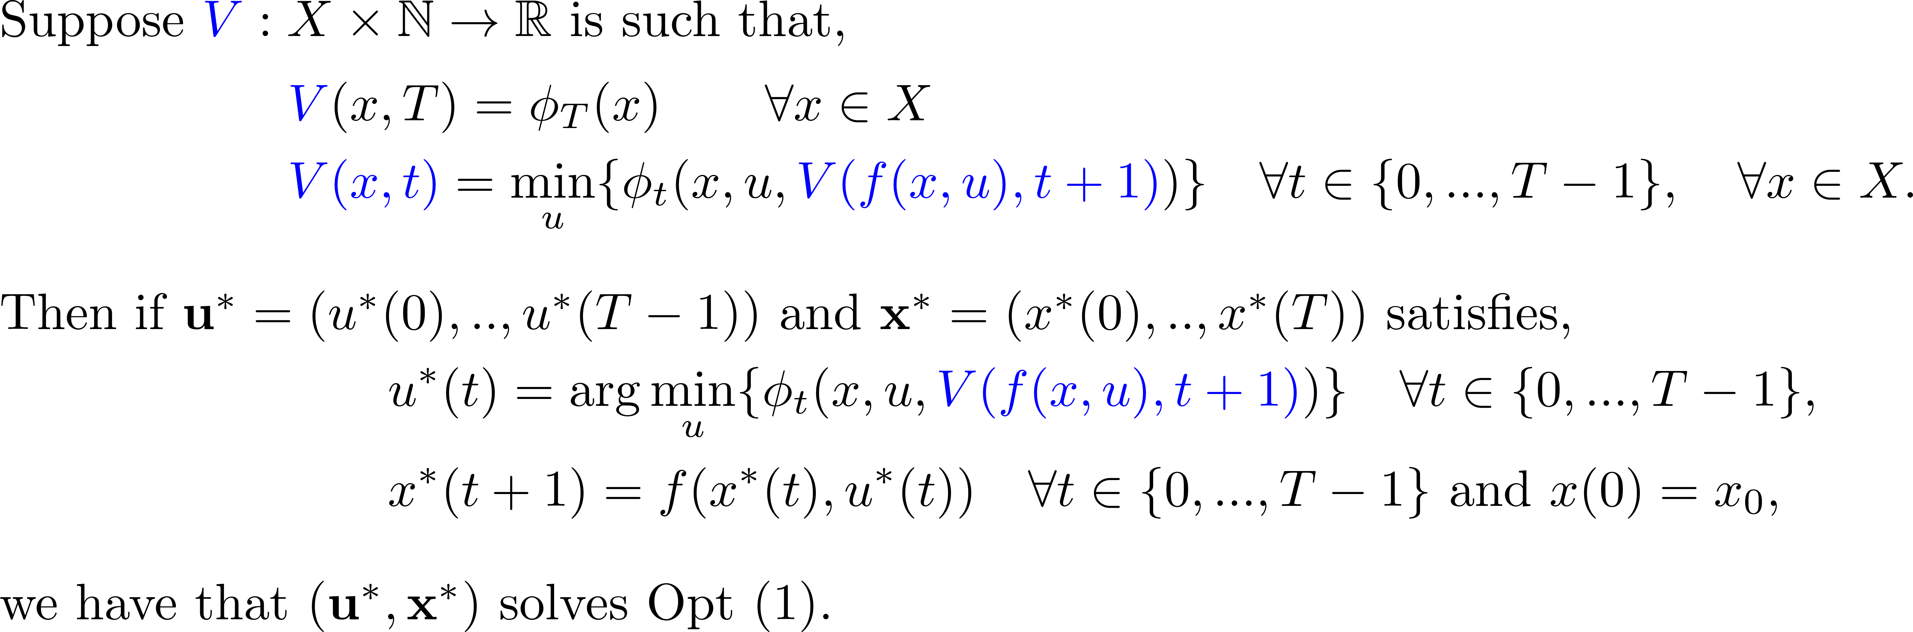
A generalization Of Bellman's Equation
Monotonically Backward Separable Cost functions
Theorem: Generalized Bellman’s Equation [3]
Requires no state augmentation!

Slide 23
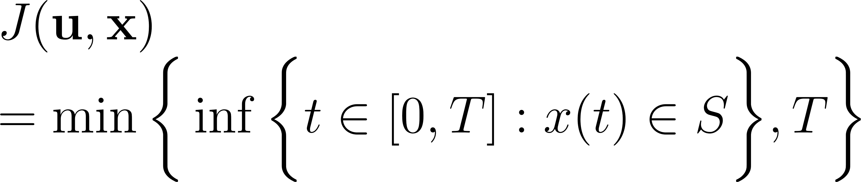
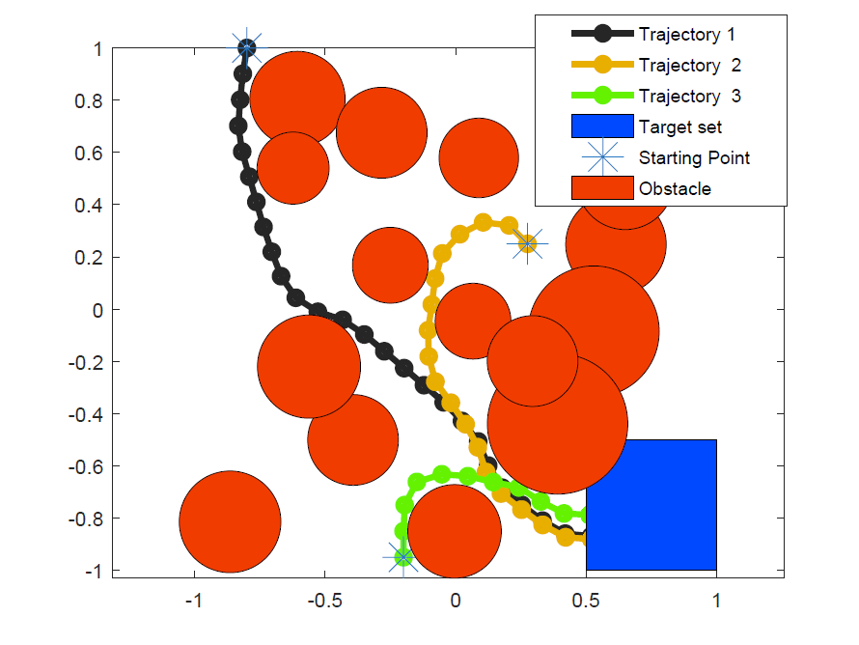
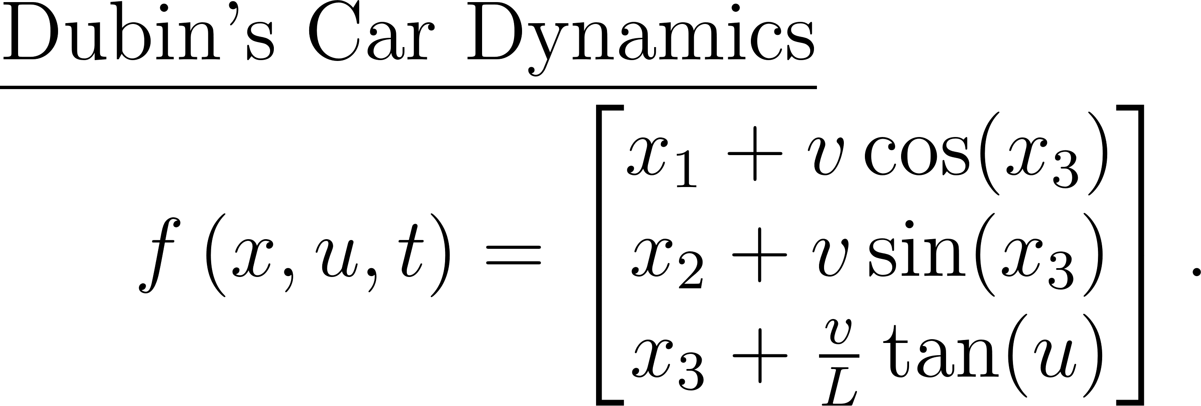
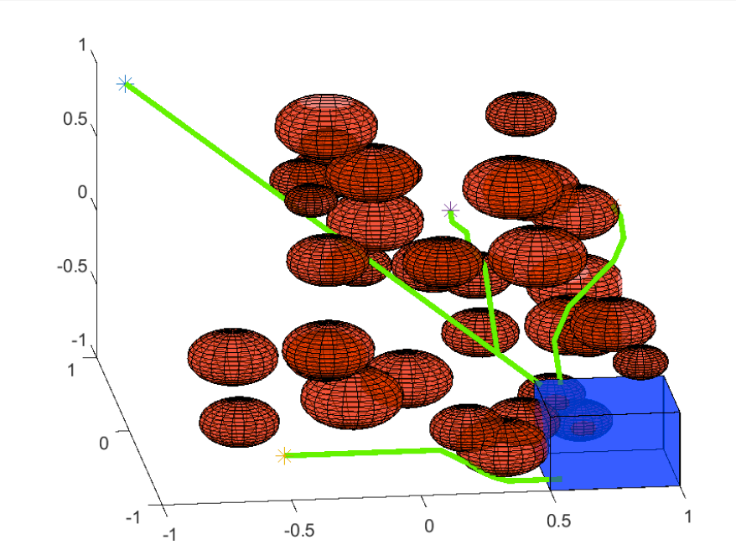
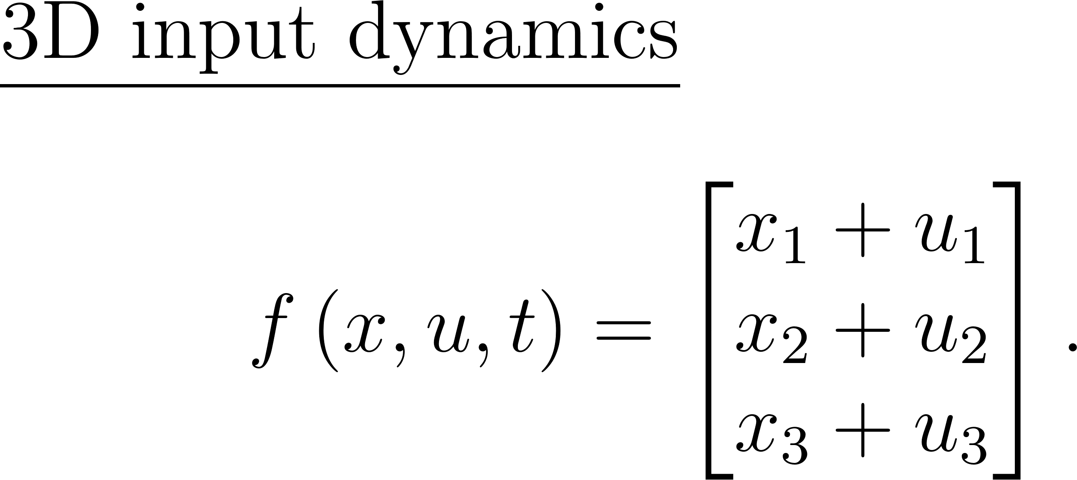
Using the GBE for Path Planning

Slide 24
C) Using SOS To Solve The HJB PDE
[4] Morgan Jones and Matthew M Peet. Polynomial approximation of value functions and nonlinear controller design with performance bounds. Under review TAC, arXiv preprint arXiv:2010.06828, 2020.
[5] Morgan Jones and Matthew M Peet. Relaxing the Hamilton Jacobi Bellman equation to construct inner and outer bounds on reachable sets. In 2019 IEEE 58th Annual Conference on Decision and Control (CDC), 2019.

Slide 25
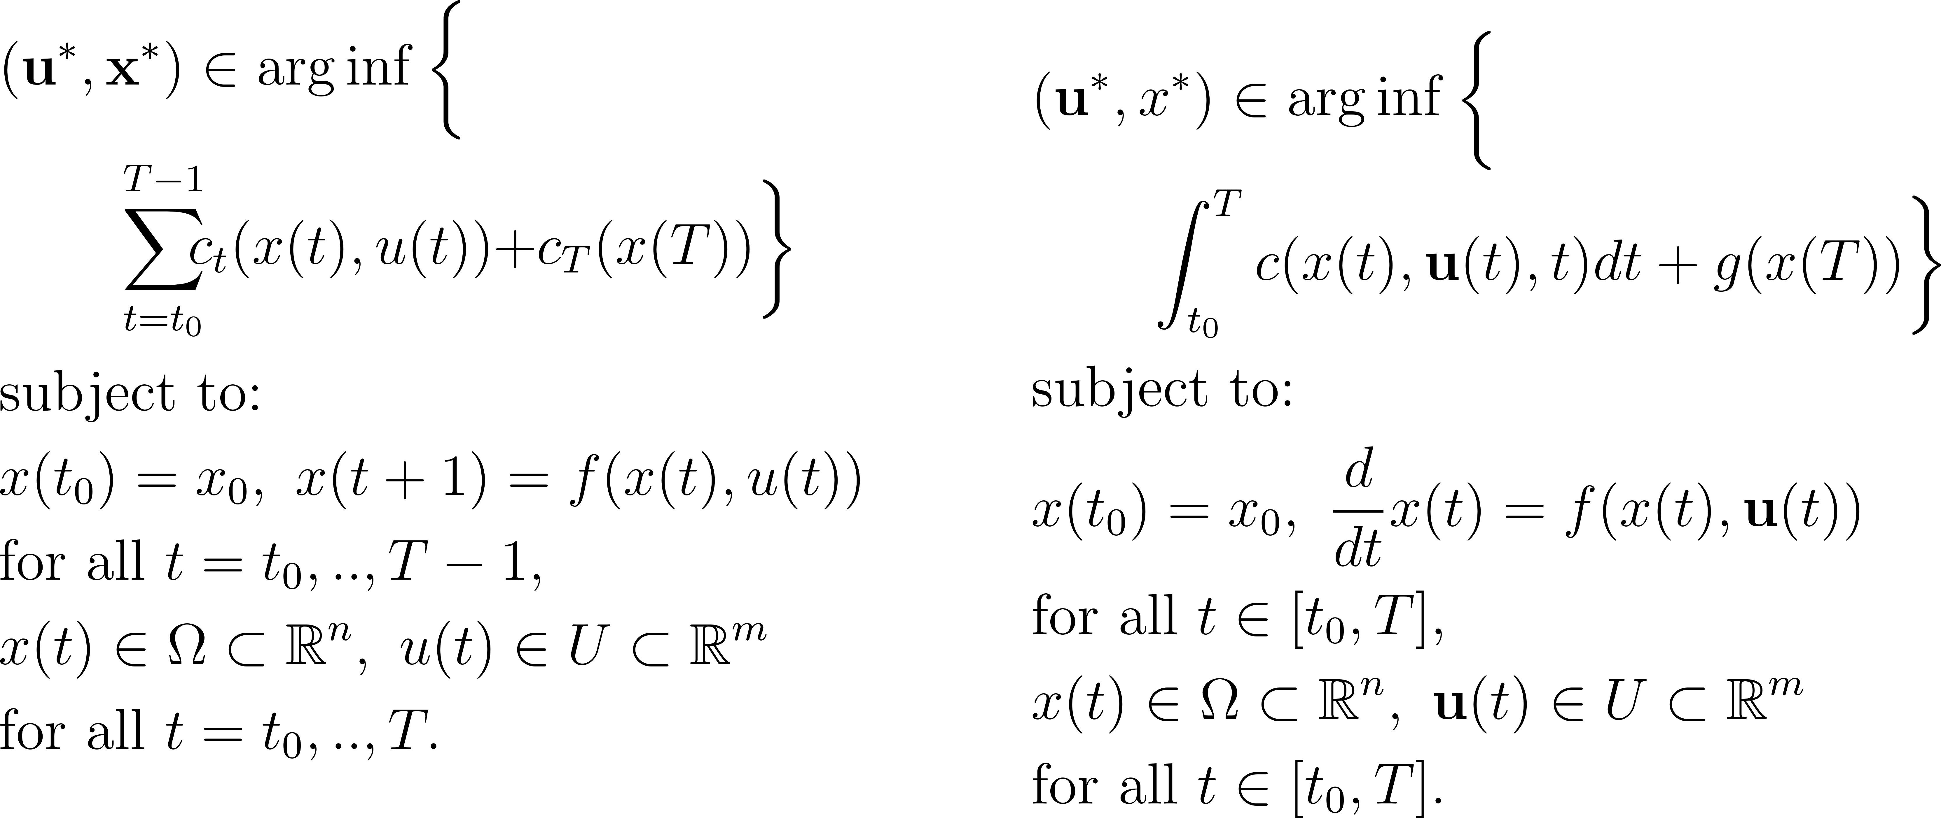


From Discrete Time to Continuous Time
Discrete Time
Continuous Time
Bellman’s Equation (BE)
Hamilton Jacobi Bellman (HJB) PDE

Slide 26






Facts About HJB PDE and Why We Want to Solve it
Value functions are known to exist but there is no general analytical formula.
Value functions give the optimal cost to go, the solution to the “tail problem”.
Solution map of ODEs are known to exist but there is no general analytical formula.

Slide 27


Dissipation Inequalities For Sub-Value Functions
Prop: Dissipation Inequalities For Sub-Value Functions

Slide 28







Linear Relaxations of the HJB PDE
Problem: We don’t have an analytical formula for $V^{∗}$ so need to remove it from the objective
Relaxation
Equivalence
Recall, constraints imply that: $V\left(x,t\right)≤V^{∗}(x,t)$

Slide 29






SOS Tightening of the HJB PDE Problem
Once you have an optimization problem linear in the decision function in the obj and constraints we can solve using SOS programing
Tightening
We can solve this SOS optimization problem using SOSTOOLS and SEDUMI on Matlab

Slide 30

Convergence of Proposed SOS Problem for VF Approximation

Slide 31





Synthesizing Optimal Controllers From Value Functions
If we don’t have an analytical formula for the VF we can sub our approximated VF from our SOS algorithm.

Slide 32





Near Optimal Controllers For the Van der Pol System
Dynamics and cost are affine in the input
Degree14 value function approximation derived from our SOS algorithm
Green= Trajectory from using $u\left(t\right)≡0$.
Red= Trajectory from using $u_{SOS}$ when $q=[0;0]$.
Blue= Trajectory from using $u_{SOS}$ when $q=[−0.4;0]$.

Slide 33








Value Functions Characterize Reachable Sets
Recall, if satisfies the HJB PDE,
Recall $ρ_{f}$ is the solution map to the ODE:
Note that by revising time (changing the sign of the vector field) we can calculate forward reachable sets .

Slide 34




Numerical Examples: Lorenz Reachable Set

Slide 35
D) Converse Lyapunov Theory
[6] Morgan Jones and Matthew M Peet. Converse Lyapunov functions and converging inner approximations to maximal regions of attraction of nonlinear systems. In 2021 IEEE 60th Annual Conference on Decision and Control (CDC), arXiv preprint arXiv:2103.12825, 2021.

Slide 36





Dynamics of The F/A-18 Fighter Jet

Slide 37



F/A-18 Fighter Jet Falling Leaf Mode
These oscillation are unsafe! Next we will develop methods that search for regions where the trajectory becomes steady, ie stable.
[Chakraborty, et all, 2011]
Notes:
Might want to say we don’t actually solve this but we take a step in the direction to try and solve such problems.

Slide 38





Regions of Stability Are Defined By Solution Maps
Assume the origin is an equilibrium point:
$$f\left(0\right)=0$$

Slide 39

Properties of Solution Maps
Unfortunately, unlike for linear ODEs, in general there is no analytical formula for the solution of map of nonlinear ODEs.
By Picard iteration we can prove there exists a solution map. Moreover, the smoothness properties of the solution map are inherited by the vector field.
Given an initial condition, we can approximately simulate the trajectory using MATLAB (or any other ODE solver).

Slide 40



Finding The Region of Attraction is Hard
We could simulate the trajectory for each $x_{0}∈S$ showing
${||ρ_{f}(x}_{0},T)|{\left.​\right|}_{2}<ε$
for sufficiently large
$T<∞$ and small $ε≪1$.
However, there might be uncountably many points in $S$and there is error in simulation.

Slide 41




Using Lyapunov Functions to Find the ROA
Finding Lyapunov functions requires no knowledge of the solution map of the ODE.
We can prove the existence of converse Lyapunov functions based on solution maps (known to exist by Picard iteration).
Converse Lyapunov functions can be used to design algorithms for ROA approximation.

Slide 42


Maximal Lyapunov Functions Characterize ROA’s
Converse Lyapunov functions are special cases of value functions (solutions to the HJB PDE)!
Problem! Maximal LFs are infinity outside of the ROA making it hard to approximate them by continuous functions.
Our proposed converse LF can be shown to be globally bounded!

Slide 43





Properties Of Our Newly Proposed Converse Lyapunov Function
We have shown that:

Slide 44




An Optimization Problem for ROA Approximation
Relax equality constraints to inequality constraints
Objective function ensures the solution to the relaxed problem is close to our proposed converse Lyapunov function.
Recalling

Slide 45




Uniformly Bounding Our Converse Lyapunov Function
Currently we cannot solve this optimization problem because we don’t have an analytical expression for $V_{α, β}$ we need to find a way to remove it from the objective.
Feasible solutions to our Opt satisfy inequalities that imply solutions bound $V_{α, β}$ from above.
We next use this fact to remove $V_{α, β}$ from the objective of our Opt.
Recalling

Slide 46




Eliminating Unknowns From our Optimization Problem
Recalling
Equivalent
Recall, constraints imply that: $V_{α, β}\left(x\right)≤V(x)$
$$⇒$$

Slide 47




An SOS Optimization Problem For ROA Approximation
Tightening
We can solve this SOS optimization problem using SOSTOOLS and SEDUMI on Matlab

Slide 48



Our SOS Optimization Problem Can yield Close ROA Inner Approximations

Slide 49





Numerical Examples: Approximating ROA’s
d=12
d=10
The reverse time Van-der-Pol Oscillator
Third order servomechanism

Slide 50
Summary
Discrete Time:
Defined a class of objective functions, Forward Separable Functions, for which it is tractable to do state augmentation.
Used our state augmentation method to solve the residential battery scheduling problem to minimize demand charges.
Derived optimality conditions for MSOPs with Monotonically Backward Separable (MBS) costs functions, the Generalized Bellman Equation (GBE).
Continuous time
Proposed a sequence SOS problem that yield polynomials that converge to the solution to the HJB PDE in the L1 norm.
Used our proposed SOS problem to approximate value functions to synthesize near optimal controllers and bound reachable sets.
Proposed a new converse Lyapunov function for region of attraction approximation.

Slide 51
Thanks To My Advisors, Collaborators And Colleagues
Advisor: Matthew Peet.
Colleagues: Hesameddin Mohammadi, Brendon Colbert, Sachin Shivakumar, Reza Kamyar, Amritam Das, Declan Jagt, Alexandr Talitsky, Lucas Lugnani Fernandes, Pedro Peres, and Ricardo Oliveira.
Comittee members: Angelia Nedich, Marc Mignolet, Matthias Kawski, and Spring Berman..
The Audience

Slide 52
Any Questions?

